Slide 1
Fig. 1 — Graphical Abstract
Pipeline comparison: isotropic HMM (top) vs. covariance-aware CMM (bottom)
SVG source embedded — double-click to open for vector editing

Slide 2
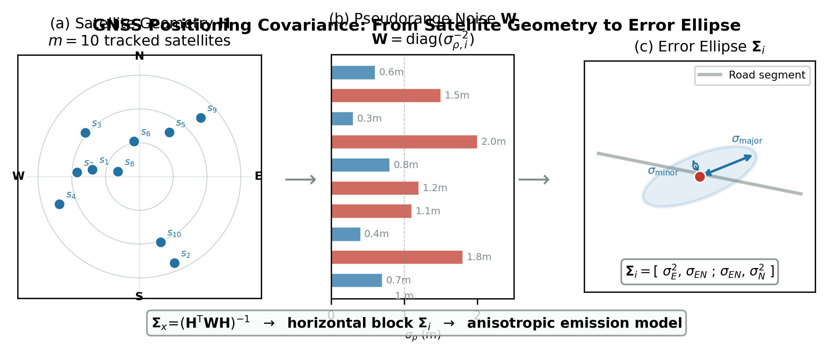
Fig. 4 — GNSS Covariance Formation
3-panel: skyplot, pseudorange noise model, error ellipse with semi-axes
SVG source embedded — double-click to open for vector editing

Slide 3
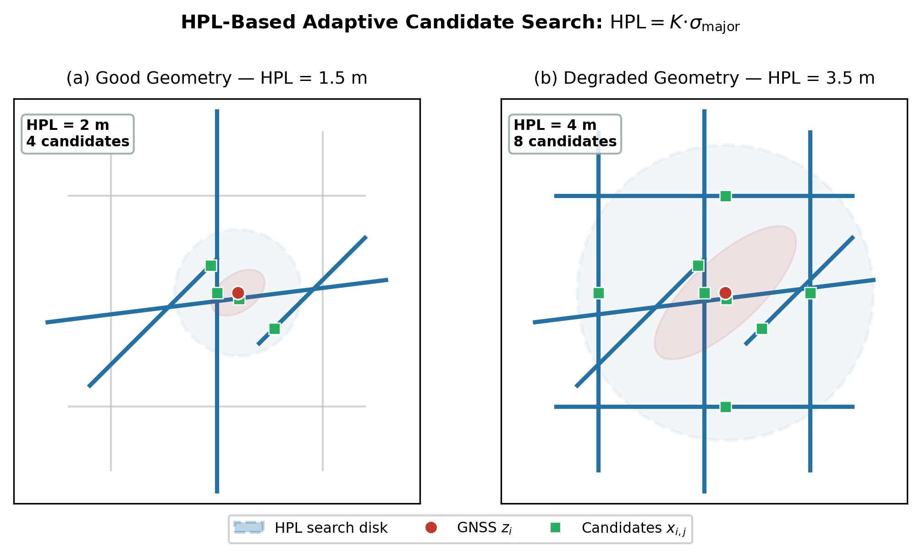
Fig. 5 — HPL-Based Adaptive Candidate Search
2-panel: good geometry (tight search) vs. degraded geometry (wide search)
SVG source embedded — double-click to open for vector editing

Slide 4
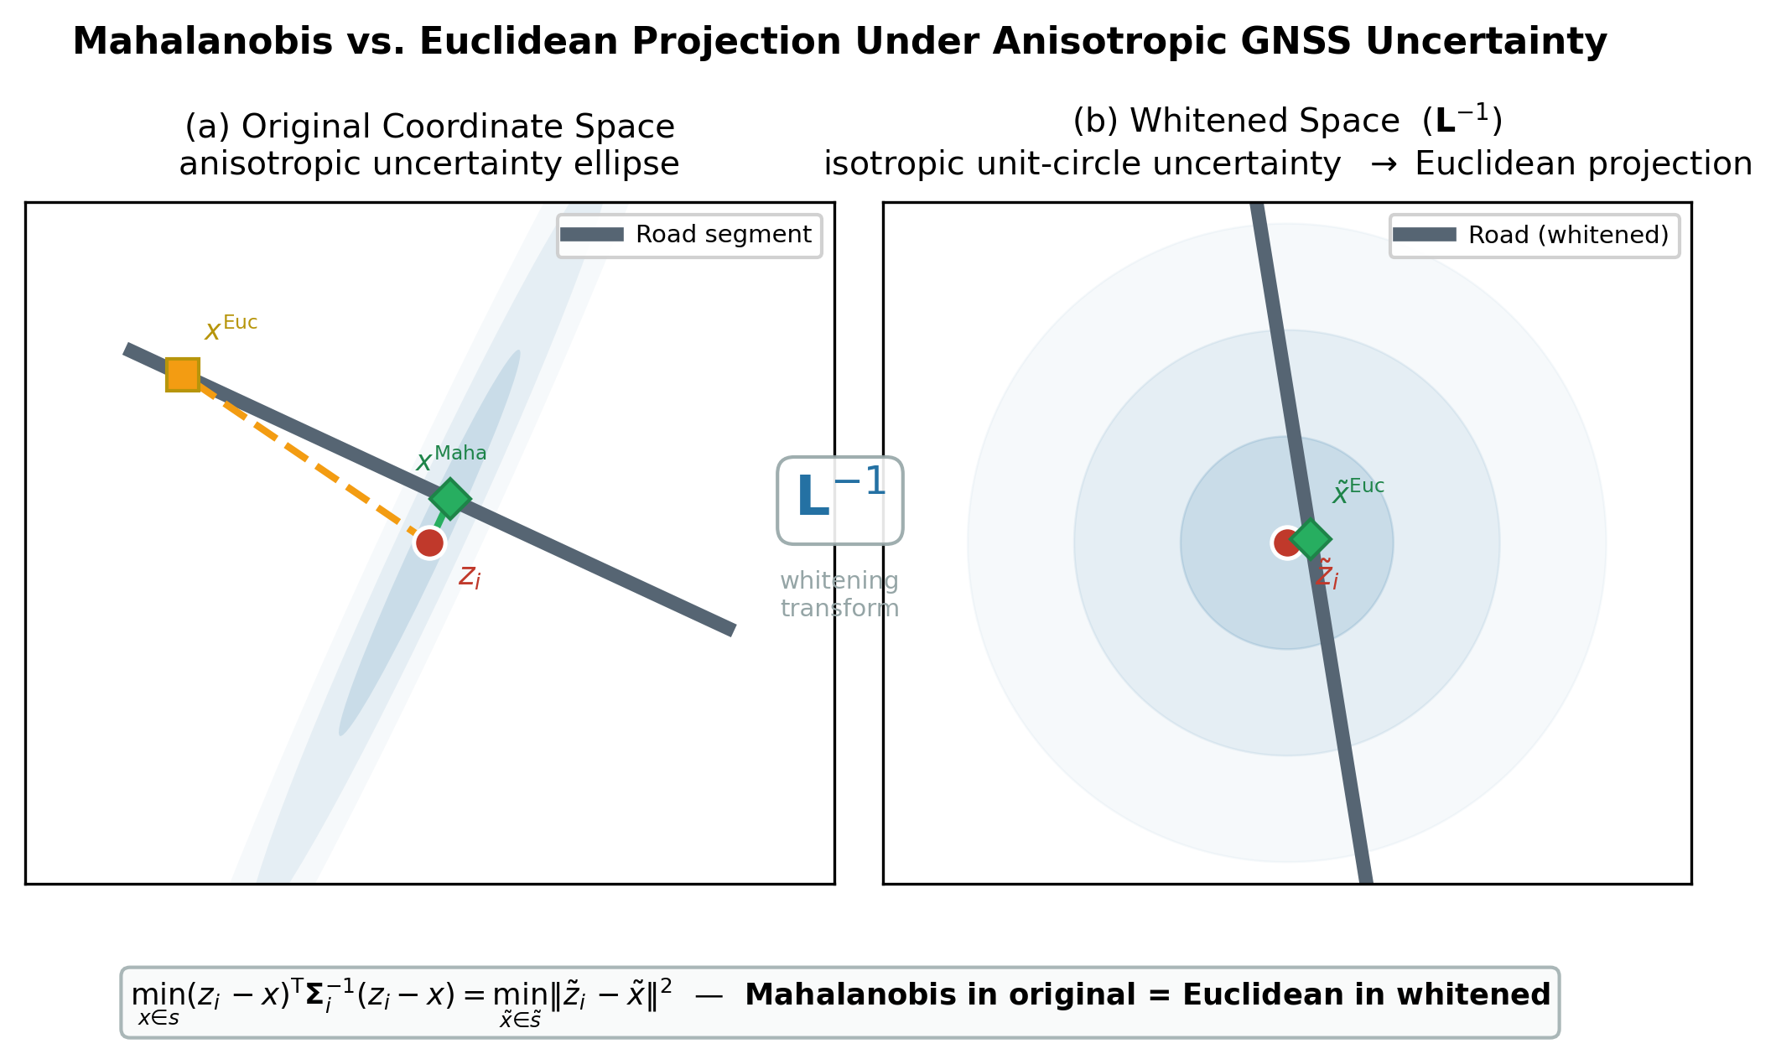
Fig. 6 — Mahalanobis vs. Euclidean Projection
Original anisotropic space vs. whitened isotropic space, Cholesky transform
SVG source embedded — double-click to open for vector editing

Slide 5
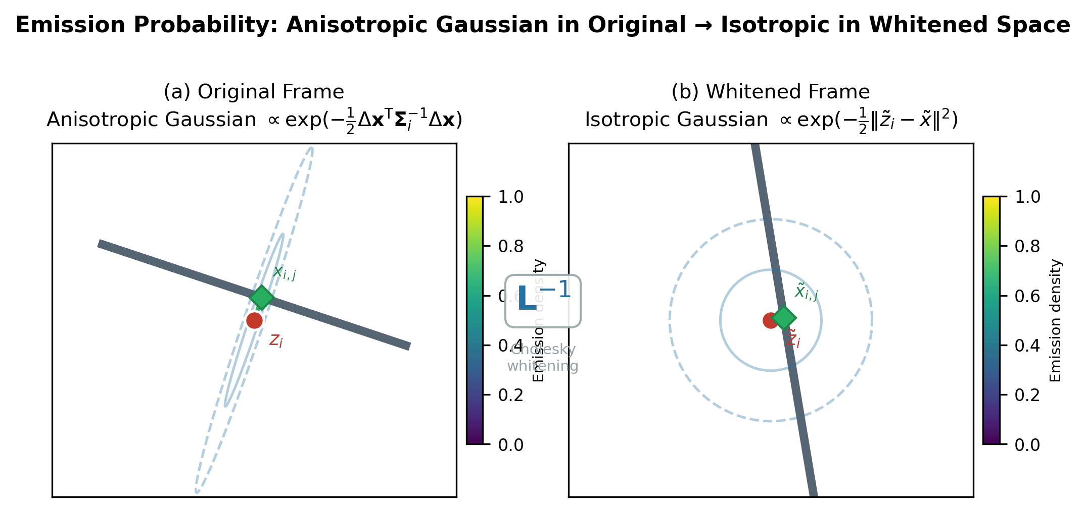
Fig. 7 — Emission Probability Under Whitening
Anisotropic Gaussian emission → isotropic Euclidean via Cholesky whitening
SVG source embedded — double-click to open for vector editing

Slide 6
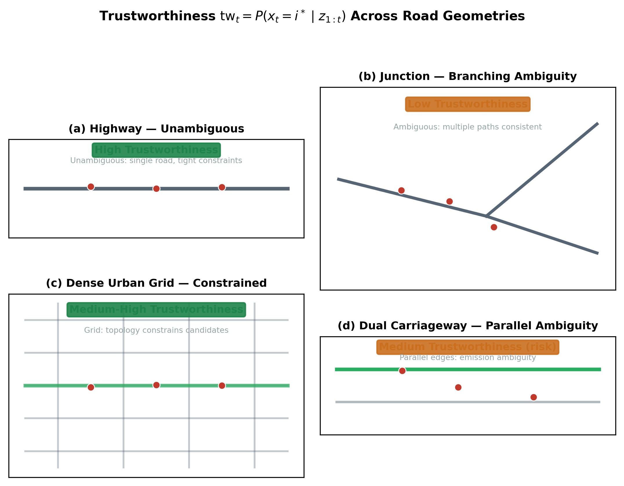
Fig. 8 — Trustworthiness Across Road Geometries
2x2: highway (high TW), junction (low), urban grid (medium-high), dual carriageway
SVG source embedded — double-click to open for vector editing

Slide 7
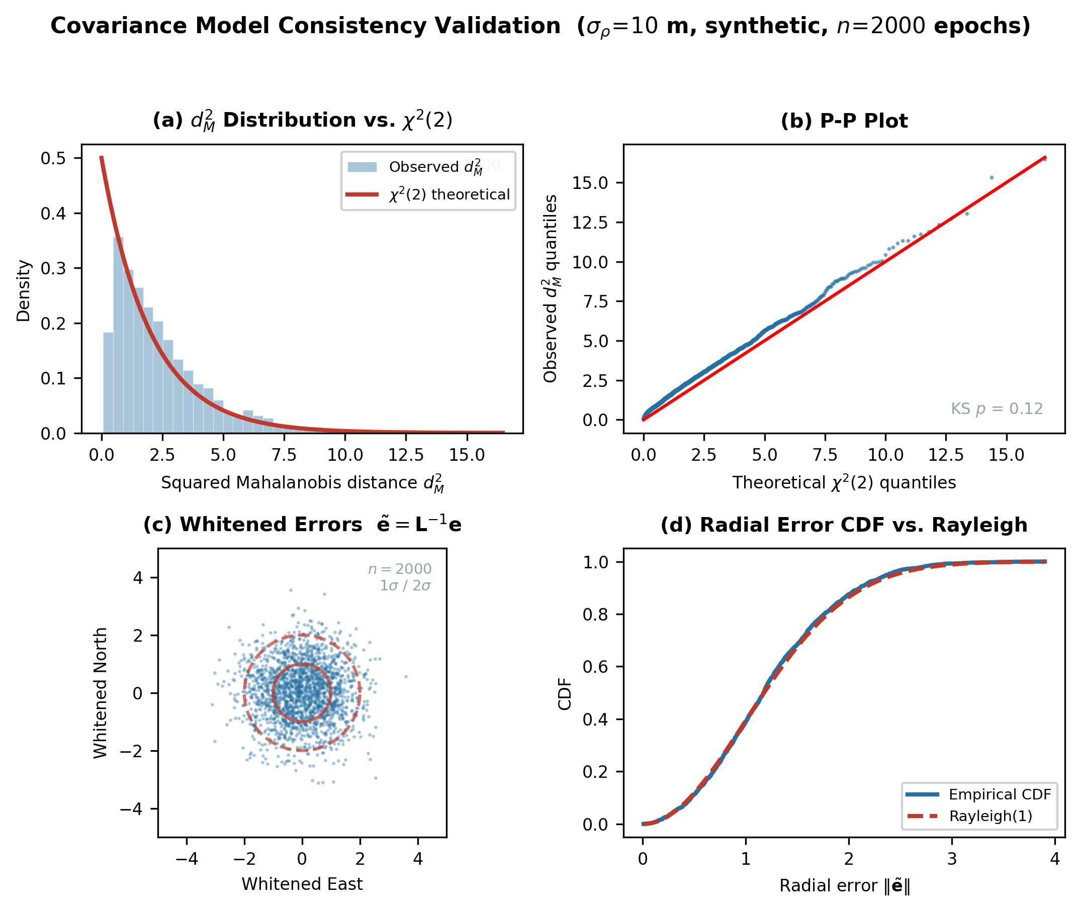
Fig. 9 — Covariance Model Consistency Validation
4-panel: chi-squared fit, P-P plot, whitened errors, radial CDF vs Rayleigh
SVG source embedded — double-click to open for vector editing

Slide 8
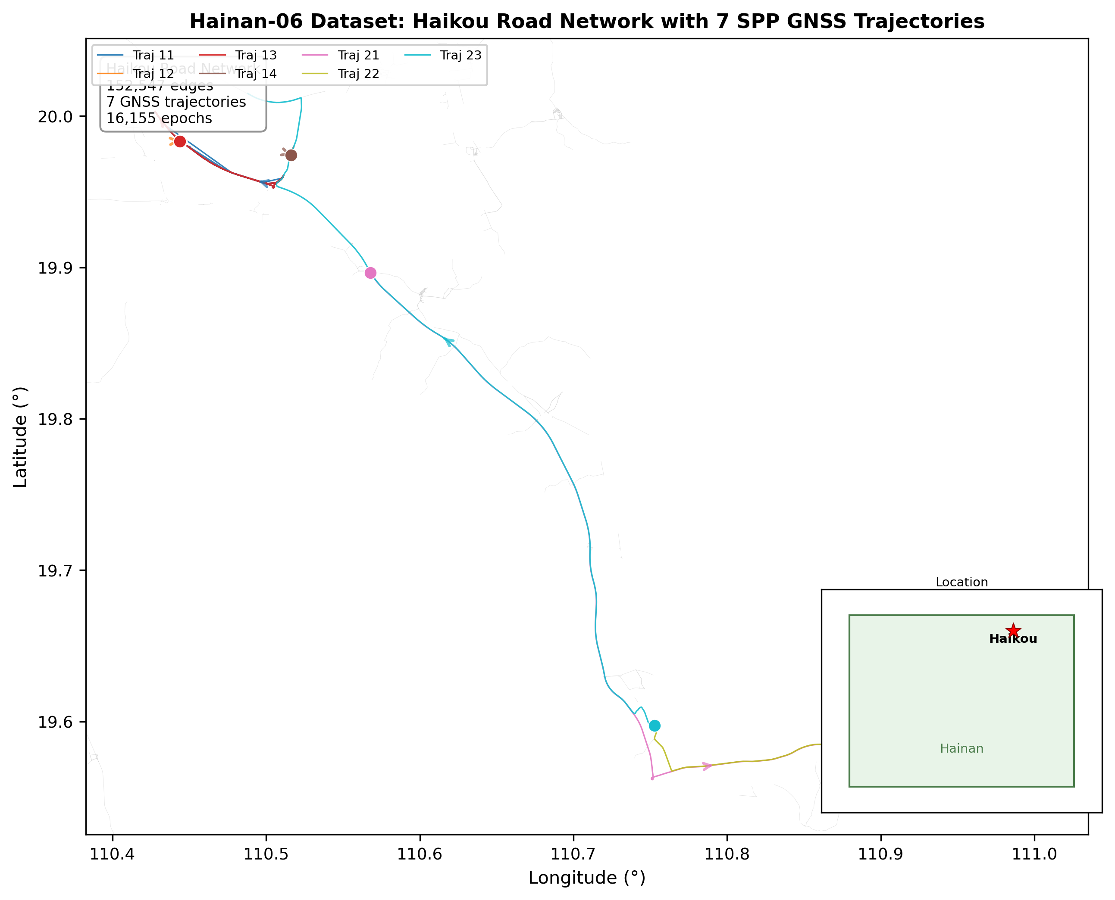
Fig. 16 — Hainan-06 Dataset Overview
Haikou road network (152K edges) with 7 colored SPP trajectories + location inset
SVG source embedded — double-click to open for vector editing

